Slide 1

Finding Your Way in the COVID-19
World of Hotel Profitability

Slide 3
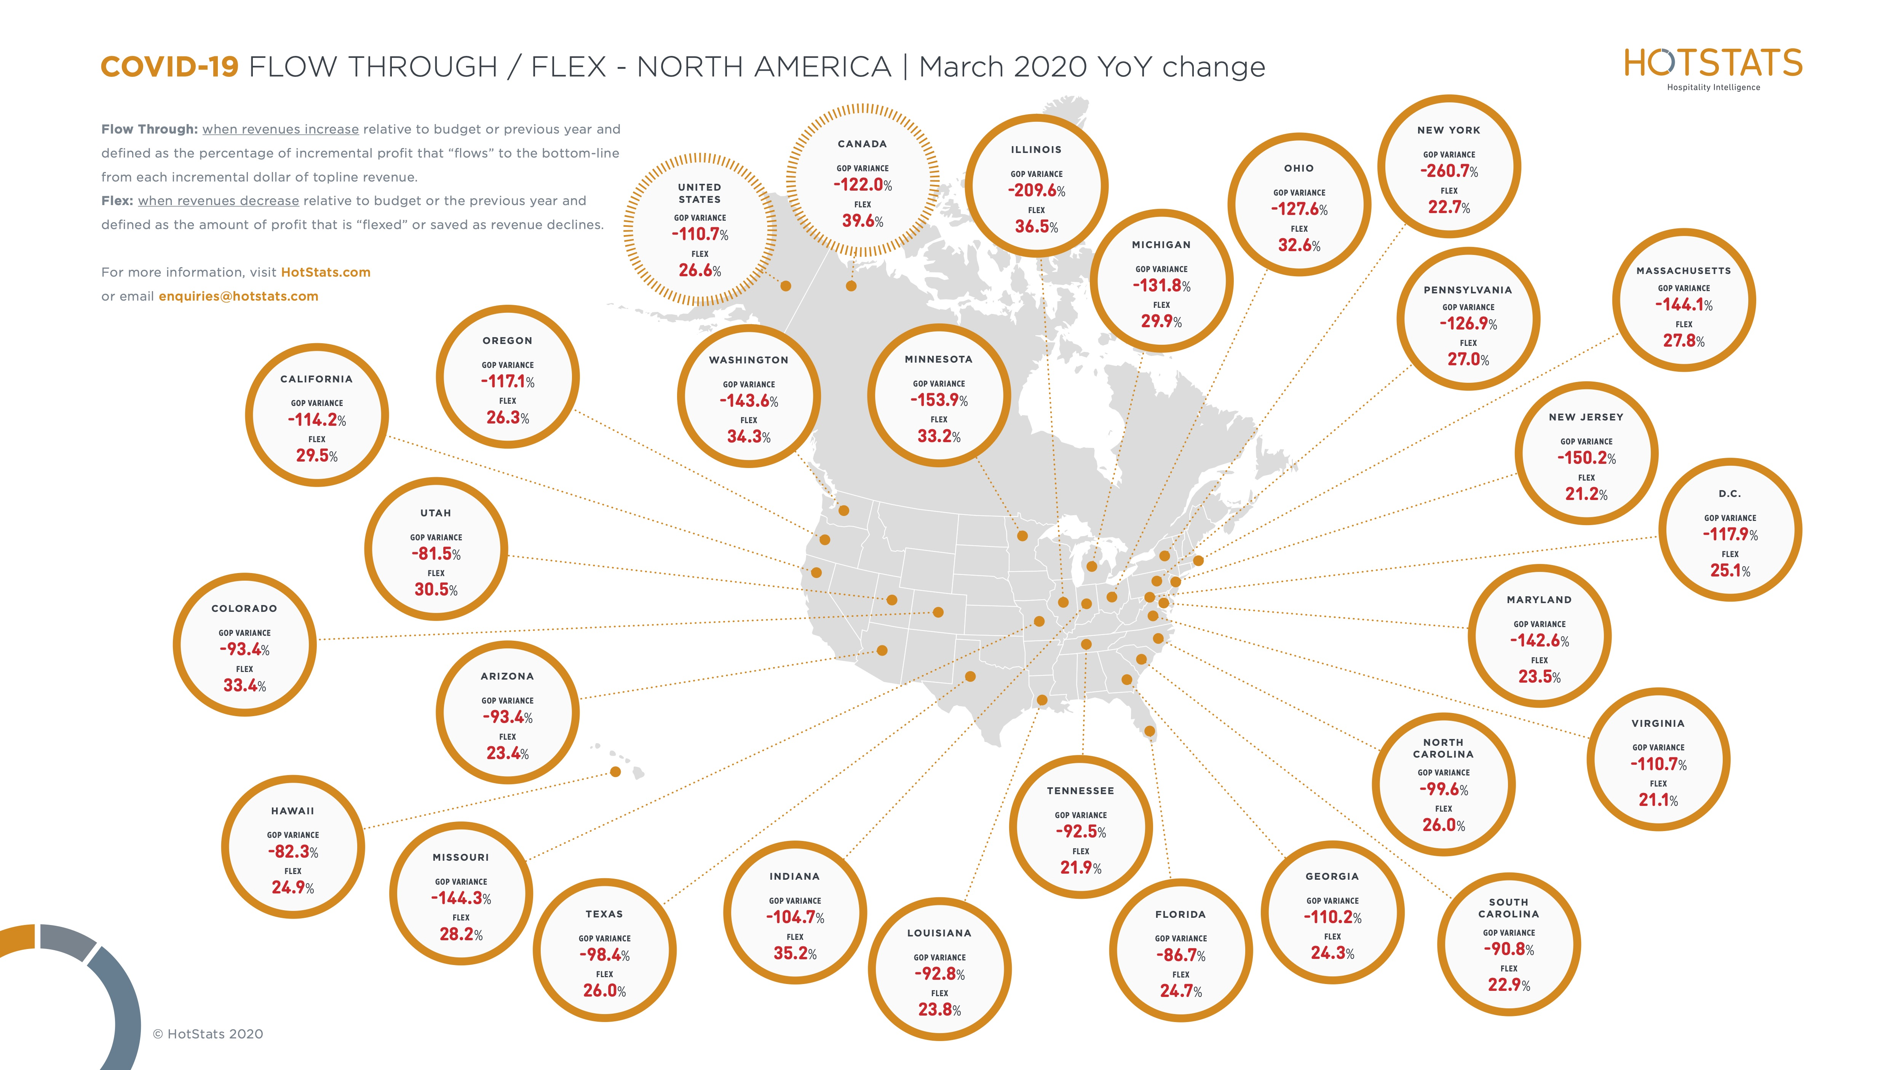

Slide 5
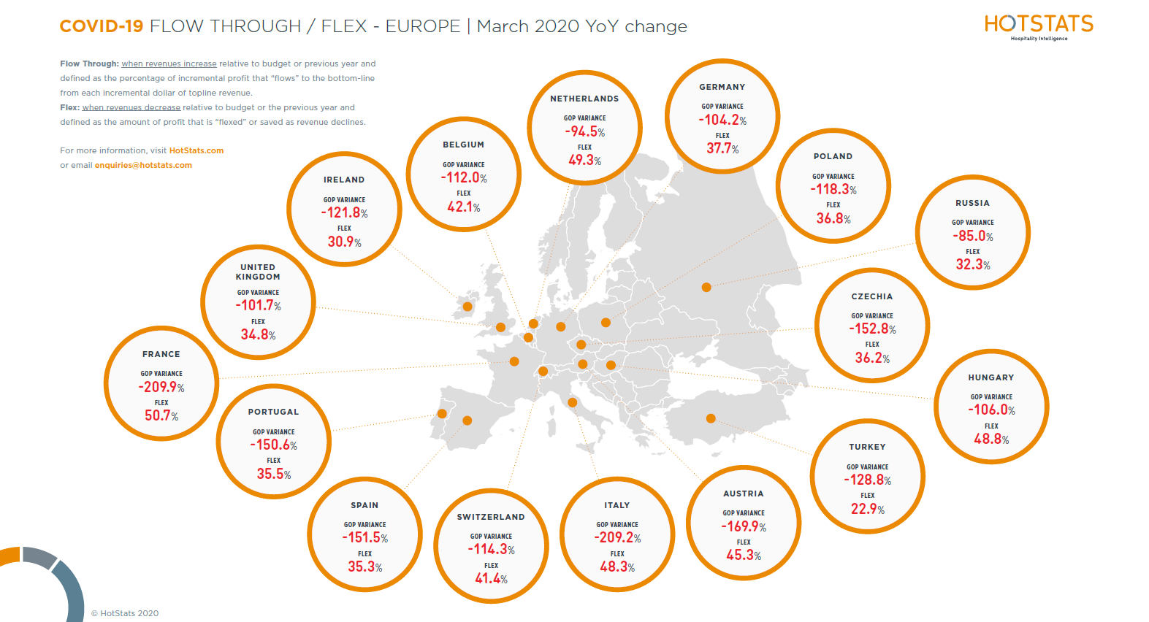

Slide 8
